Slide 1
Accelerated Path-Based Timing Analysis with MapReduce
Tsung-Wei Huang and Martin D. F. Wong
Department of Electrical and Computer Engineering (ECE)
University of Illinois at Urbana-Champaign (UIUC), IL, USA
2015 ACM International Symposium on Physical Design (ISPD)
Notes:
ECE Main Slide

Slide 2
Outline
Path-based timing analysis (PBA)
Static timing analysis
Performance bottleneck
Problem formulation
Speed up the PBA
Distributed computing
MapReduce programming paradigm
Experimental result
Conclusion

Slide 3
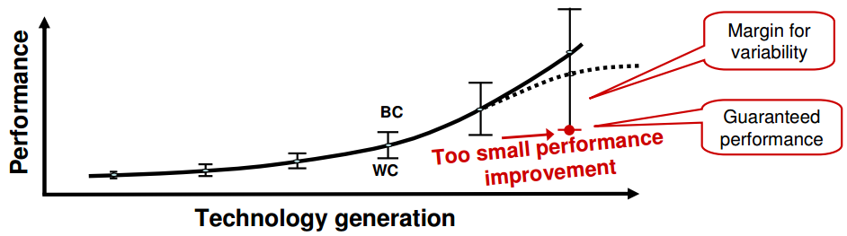
Static Timing Analysis (STA)
Static Timing analysis
Verify the expected timing characteristics of integrated circuits
Keep track of path slacks and identify the critical path with negative slack
Increasing significance of variance
On-chip variation such as temperature change and voltage drop
Perform dual-mode (min-max) conservative analysis
Notes:
We all know STA is an important step in the design flow.

Slide 4
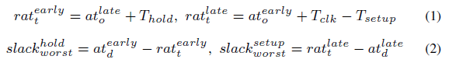
Timing Test and Verification of Setup/Hold Check
Sequential timing test
Setup time check
“Latest” arrival time (at) v.s. “Earliest” required arrival time (rat)
Hold time check
“Earliest” arrival time (at) v.s. “Latest” required arrival time (rat)
Earliest rat
(hold test)
Latest rat
(setup test)
Passing (positive slack)
Failing
Failing
time
Hold violation ☹
No violation ☺
Setup violation ☹
Notes:
One important task of the STA is the sequential timing tests which verifies the timing using setup/hold guard.

Slide 5
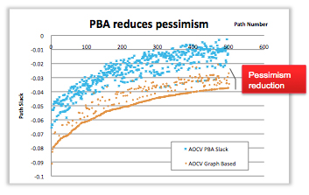
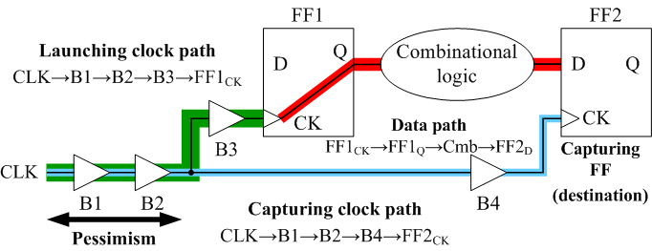
Two Fundamental Solutions to STA
Block-based timing analysis
Linear topological propagation
Worst quantities for each point
Very fast, but pessimistic
Path-based timing analysis
Analyze timing path by path instead of single points
Common path pessimism removal (CPPR), advanced on chip variation (AOCV), etc
Reduce the pessimism margin
Very slow (exponential number of paths), but more accurate
*Source: Cadence Tempus white paper
Notes:
There are two fundamental solutions to the STA. The first one is the so called, block-based timing analysis, which performs linear topological scan on the circuit and propagate the timing based the topological order. During the propagation, we keep track of the “worst” timing quantities on each point…

Slide 6
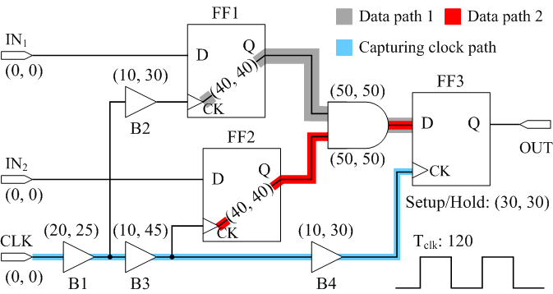
CPPR Example – Data Path Slack with CPPR Off
Pre common-path-pessimism-removal (CPPR) slack
Data path 1: ((120+(20+10+10))-30) – (25+30+40+50) = -15 (critical)
Data path 2: ((120+(20+10+10))-30) –(25+45+40+50) = -30 (critical)

Slide 7
CPPR Example – Data Path Slack with CPPR On
Post common-path-pessimism-removal (CPPR) slack
Data path 1: ((120+(20+10+10))-30) – (25+30+40+50)+5 = -10 (critical)
Data path 2: ((120+(20+10+10))-30) –(25+45+40+50)+40 = 10
+5
CPPR 1
CPPR 2
+40

Slide 8
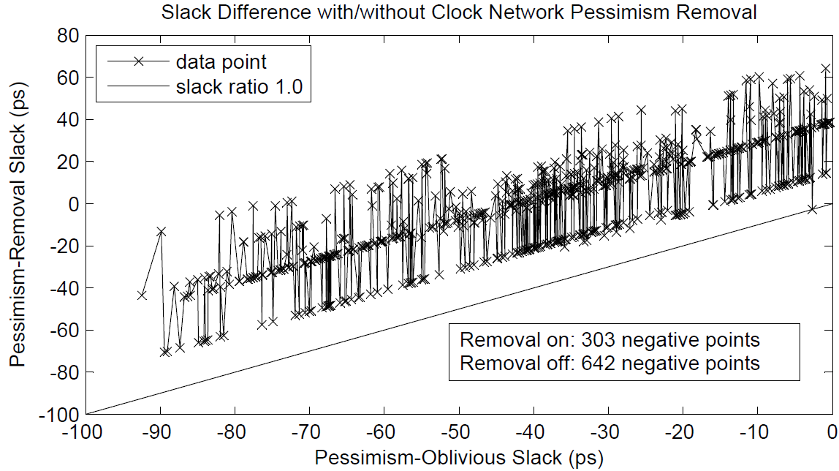
Example: Impact of Common-Path-Pessimism Removal (CPPR)

Slide 9
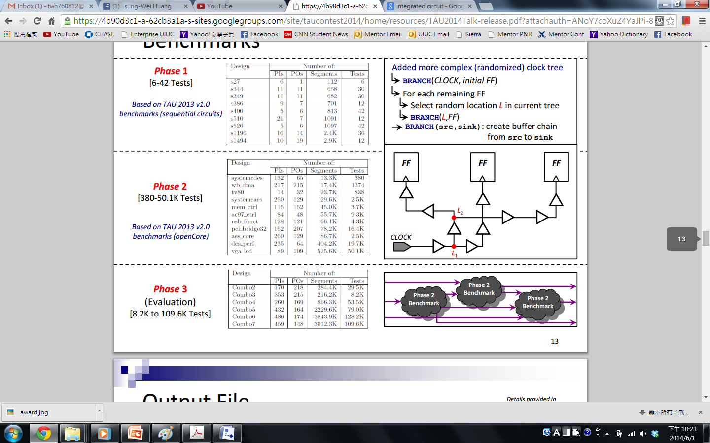
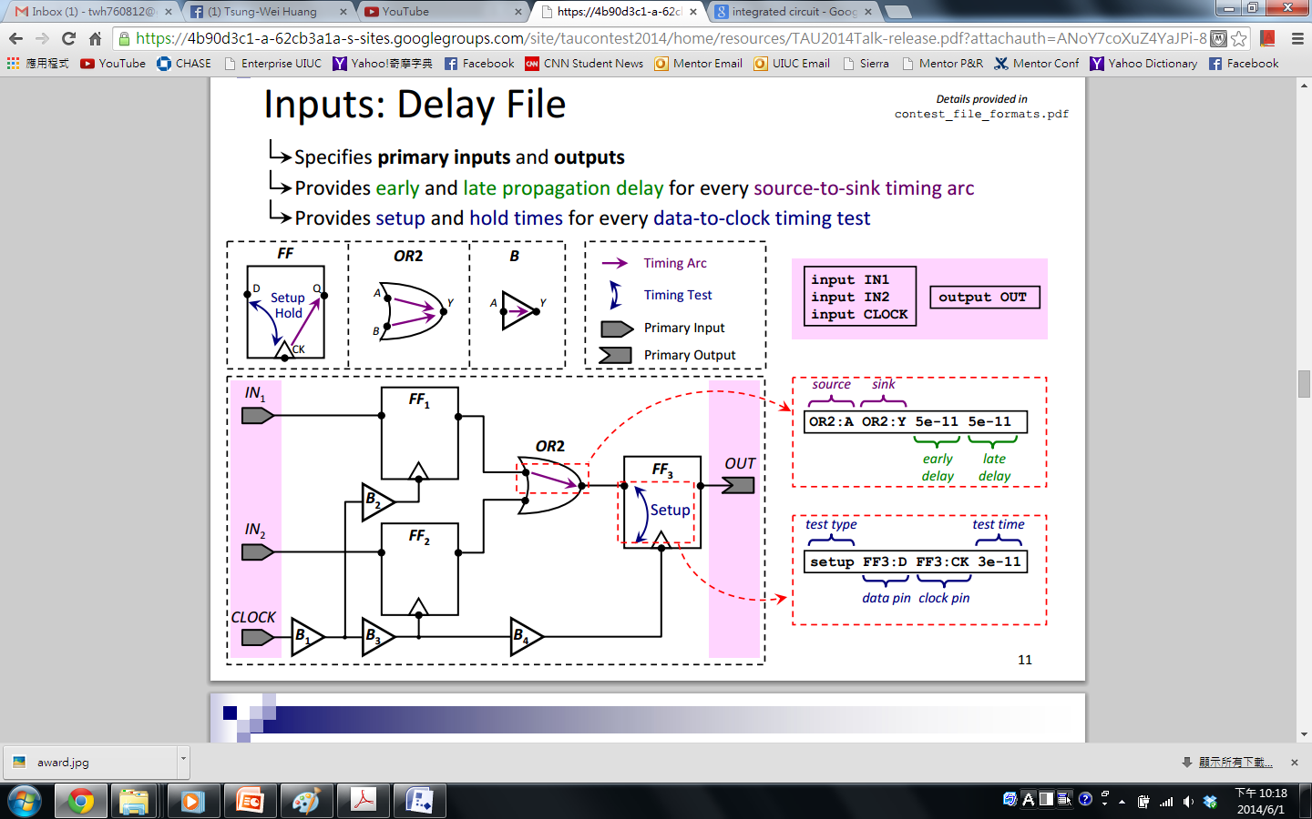
Problem Formulation of PBA
Consider the key coding block of PBA
After block-based timing propagation
Early/Late delay on edges
Input
A given circuit G=(V, E)
A given test set T
A parameter k
Output
Top-k critical paths in the design
Goal & Application
CPPR from TAU 2014 Contest
Speed up the PBA time
Clock tree
Benchmark from TAU 2014 CAD contest

Slide 10
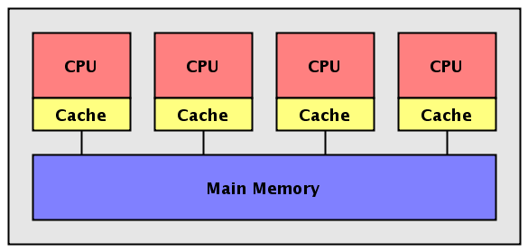
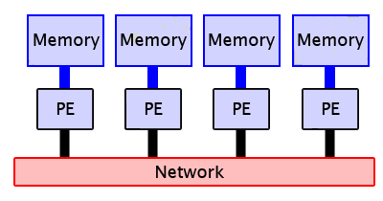
Key Observation of PBA
Time-consuming process but…
Multiple timing tests (e.g., setup, hold, PO, etc) are independent
Graph-based abstraction isolates the process of each timing test
High parallelism
Multi-threading
Shared-memory-based architecture
Single computing node with multiple cores
Distributed computing
Distributed-memory-based architecture
Multiple computing nodes + multiple cores
Goal of this paper!

Slide 11
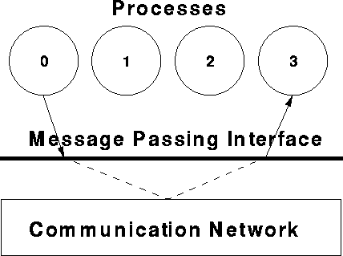
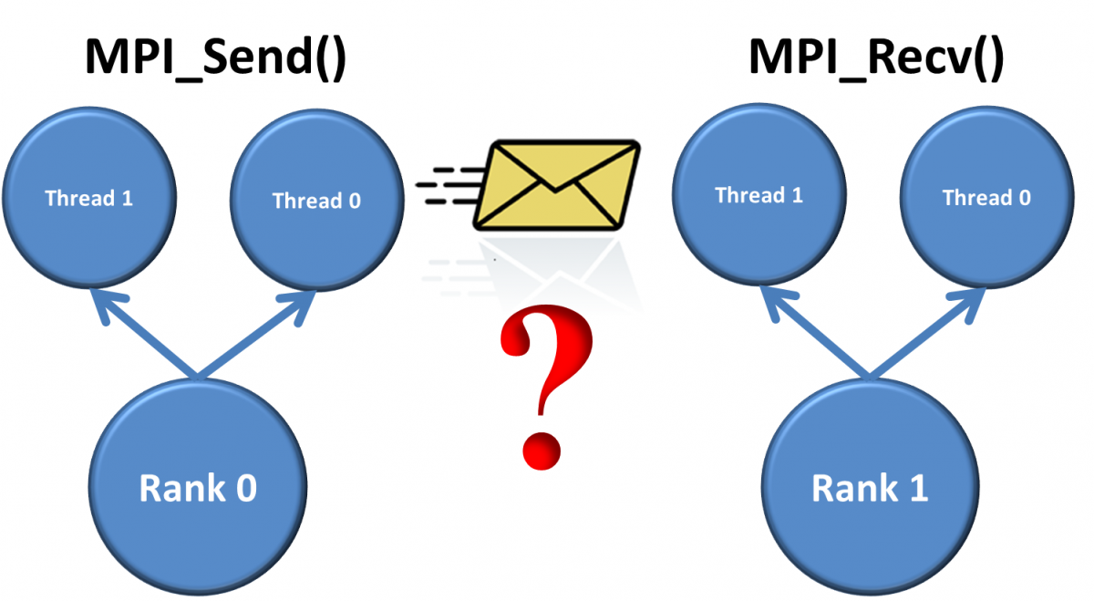
Conventional Distributed Programming Interface
Advantage
High parallelism, multiple computing nodes with multiple cores ☺
Performance typically scales up as the core count grows ☺
MPI programming library
Explicitly specify the details of message passing ☹
Annoying and error-prone ☹
Very long development time and low productivity ☹
Highly customized for performance tuning ☺
MPI_Init
MPI_Send
MPI_Recv
MPI_Isend
MPI_Irecv
MPI_Reduce
MPI_Scatter
MPI_Gather
MPI_Allgather
MPI_Allreduce
MPI_Barrier
MPI_Finalize
MPI_Grid
MPI_Comm
MPI …
Notes:
The distributed programming is advantageous in … The conventional programming interface to distributed computing is the MPI library.

Slide 12
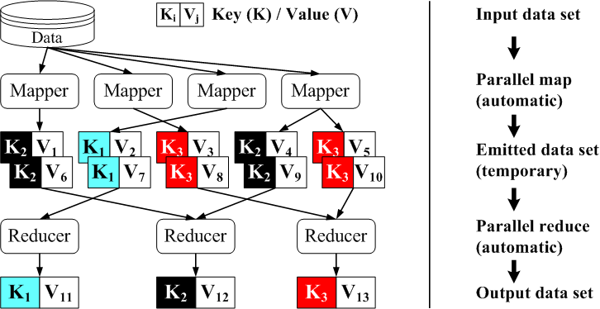
MapReduce – A Programming Paradigm for Distributed System
First introduced by Google in 2004
Simplified distributed computing for big-data processing
Open source library
Hadoop (Java), Scalar (Java), MRMPI (C++), etc.
Notes:
Because of this problem on MPI, Google first introduces the concept of MapReduce. MapReduce is a programming paradigm that simplifies distributed computing for big-data processing.

Slide 13
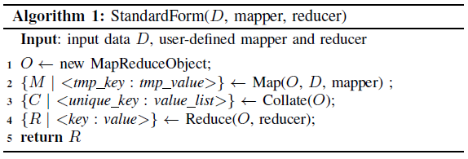
Standard Form of a MapReduce Program
Map operation
Partition the data set into pieces and assign work to processors
Processors generate output data and assign each string a “key”
Collate operation
Output data with the same key are collected to an unique processor
Reduce operation
Derive the solution from each unique data set
MPI_Isend…
MPI_Irecv…
MPI_SEND…
M…
MPI_Send…
MPI_Recv…
MPI_Barrier…
…
Tradition MPI program
(> 1000 lines)
MapReduce program (<10 lines)

Slide 14
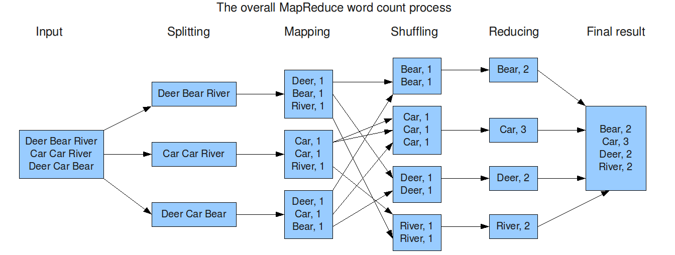
Example - Word Counting
Count the frequency of each word across a document set
3288 TB data set
10 min to finish on Google cluster

Slide 15
MapReduce Solution to PBA (I)
Map
Partition the test set across available processors
Each processor generates the top k critical paths
Each path is associated with a global key (identical across all paths)
Collate
Aggregate paths with the same key and combine them to a path string
Reduce
Sort the paths from the path string and output the top k critical paths
Mapper (t)
Generate the search for test t
Find top k critical paths for t
Emit K-V pair for each path
Reducer (s)
Parse path from path string s
Sort paths
Output the top k critical paths

Slide 16

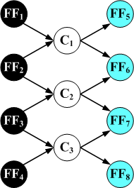
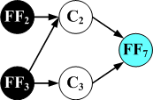


MapReduce Solution to PBA (II)
Mapper
Extract the search graph for each timing test
Find k critical paths on each search graph [Huang and Wong, ICCAD’14]
Reducer
Sort paths according to slacks and output the globally top-k critical paths
Map
Reduce
Top-1
critical path
Input circuit graph
Extraction of graph and paths

Slide 17
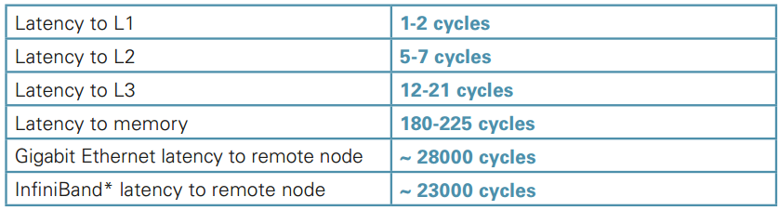
Reducing the Communication Overhead
Messaging latency to remote node is expensive
Data locality
Each computing node has a replicate of the circuit graph
No graph copy between the master node and slave nodes
Hidden reduce
Reducer call on each processor before the collate method
Reduce the amount of path strings passing through computing nodes
*Source: Intel clustered OpenMP white paper

Slide 18
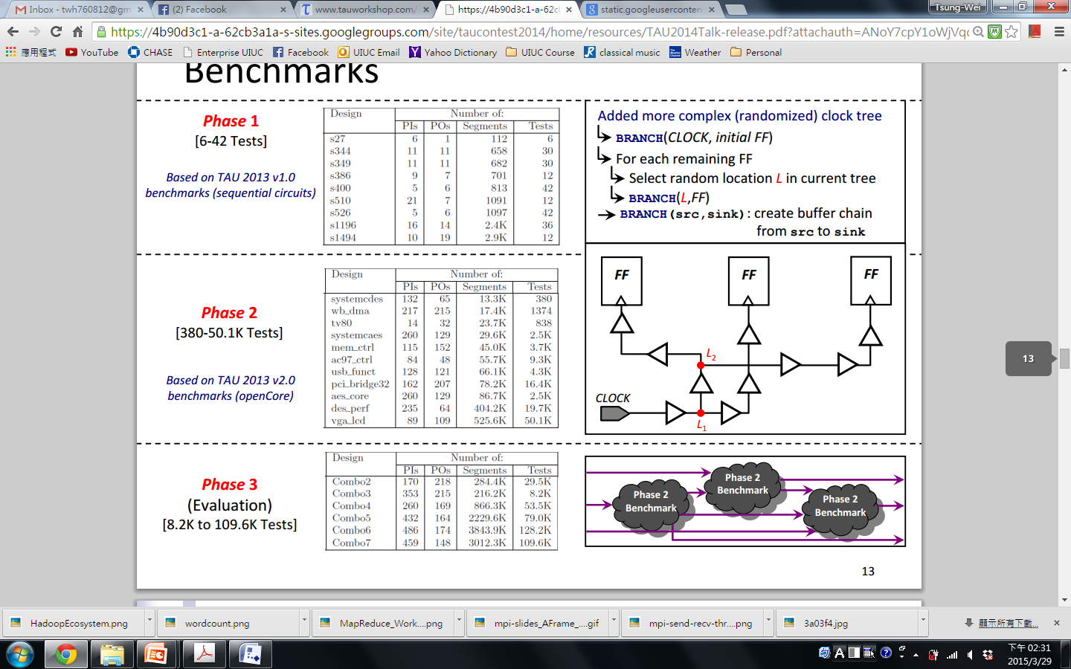
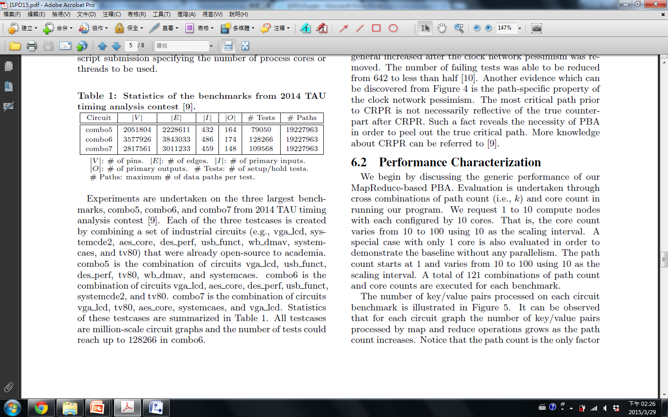
Experimental Results
Programming environment
C++ language with C++ based MapReduce library (MR-MPI)
2.26GHZ 64-bit Linux machine
UIUC Campus cluster (with up to 500 computing nodes and 5000 cores)
Benchmark
TAU 2014 CAD contest on Path-based CPPR
Million-scale circuit graphs

Slide 19
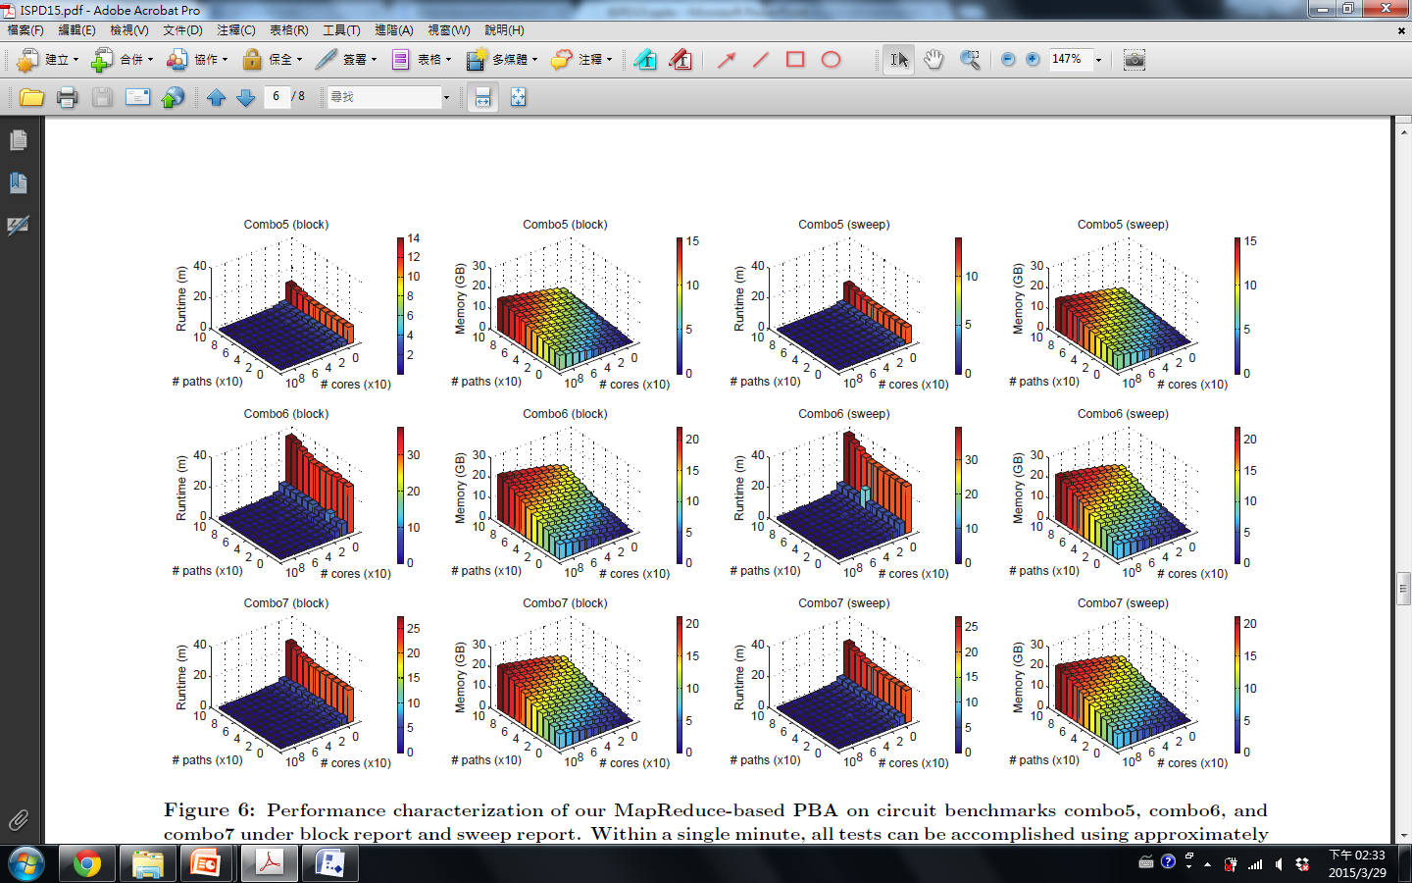
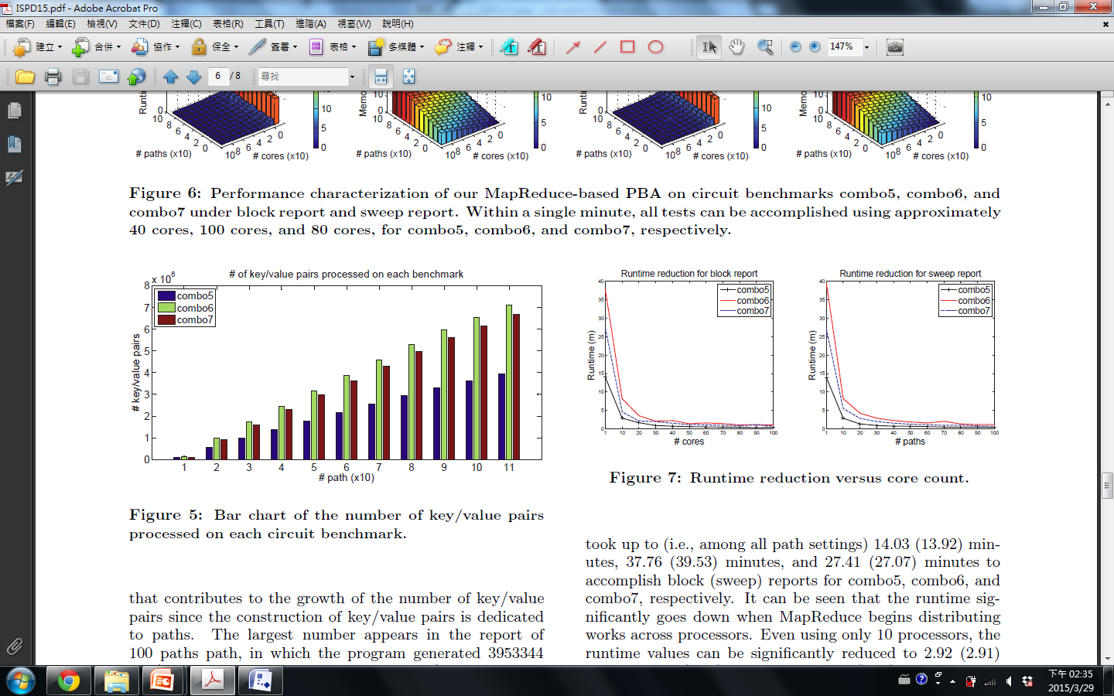
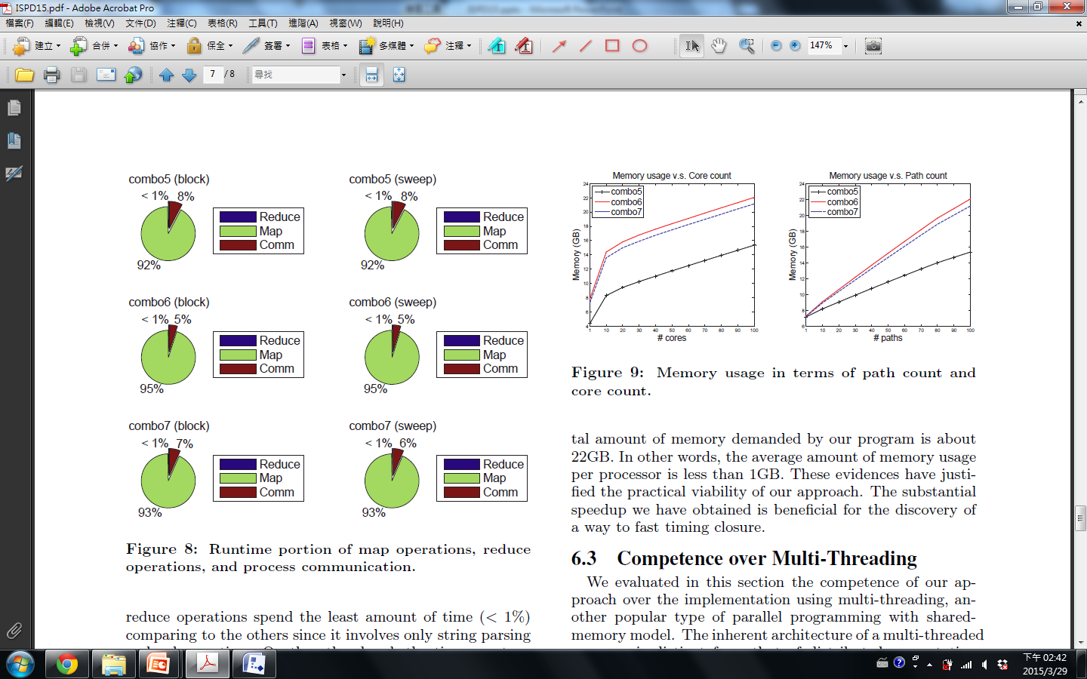
Experimental Results – Runtime (I)
Parameter
Path count K
Core count C
Performance
Only ~30 lines on MapReduce
x2 – x9 speedup by 10 cores
Promising scalability

Slide 20
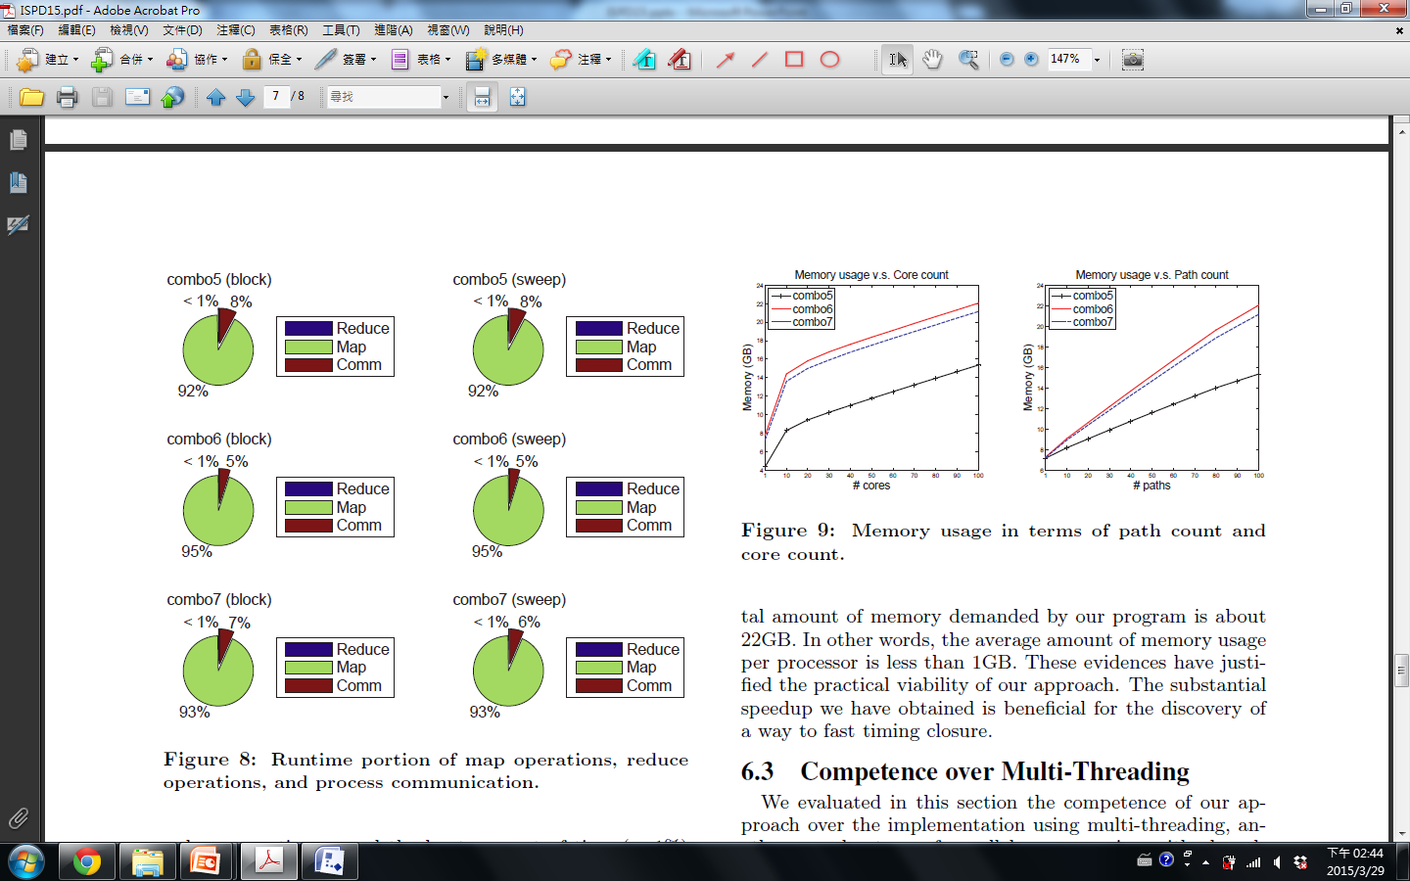

Experimental Results – Runtime (II)
Runtime portion on Map, Collate, and Reduce
Map occupies the majority of the runtime
~ 10 % on process communication
Communication overhead
Grows as the path count increases
~15 % improvement with hidden reduce

Slide 21
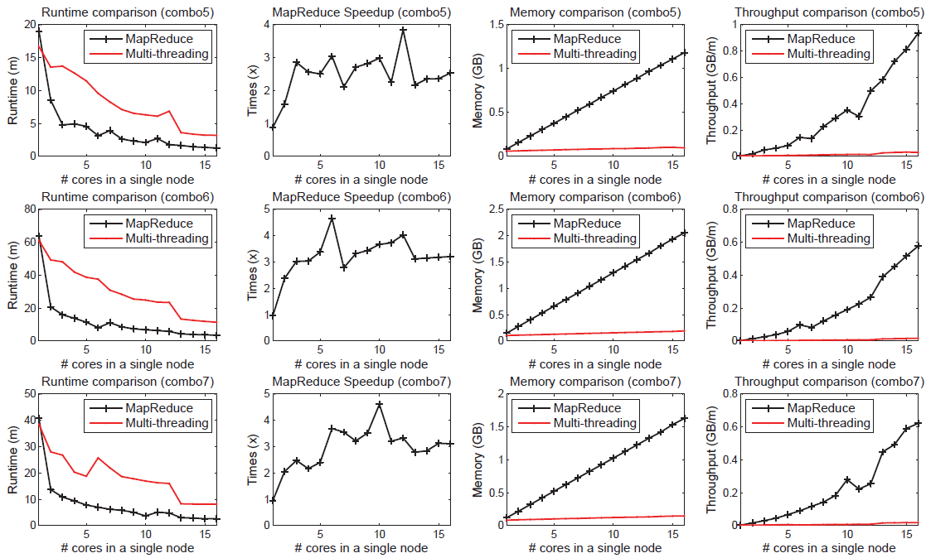
Experimental Results – Comparison with Multi-threading on a Single Node

Slide 22
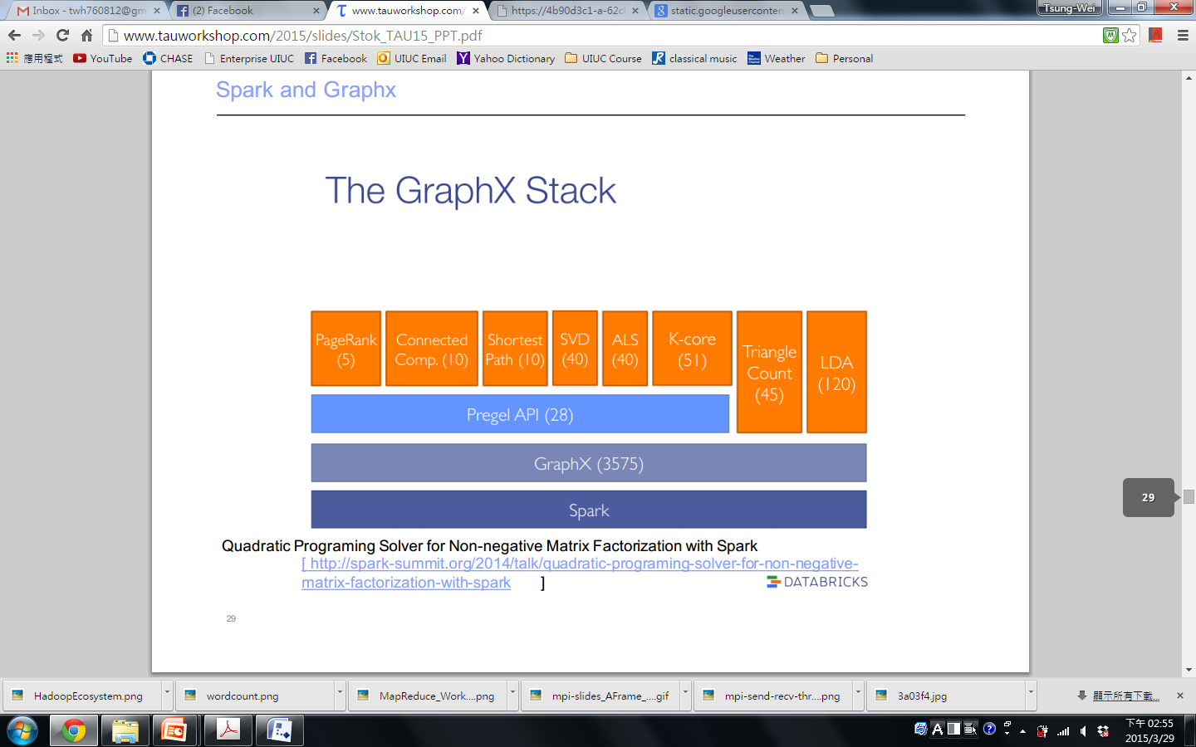


Conclusion
MapReduce-based solution to PBA
Coding ease, promising speedup, and high scalability
Analyzes million-scale graph within a few minute
Future work
Investigate more EDA applications on cluster computing
GraphX, Spark, etc.

